Slide 1

Faculty of Engineering
Department of Software Engineering and Intelligent Systems
نظام حجز مواعيد للمؤسسات الصغيرة
Appointment Booking System for Small Businesses
Prepared By:
Shahd Hilal
Firas Al-Zoubi
Supervised By
Eng. Maher Sarem
Eng. Razan Rizk
November 2026

Slide 2



Project Importance
Eliminating Manual Delays
Resource Optimization
Replaces phone calls and physical queues with instant 24/7 automated slot reservations.
Maximizes service provider capacity and balances workload across active shifts.
Automated push notifications and SMS reminders reduce missed bookings drastically.

Slide 3
Project Goals
Real-Time Dynamic Scheduling
Centralized Service Catalog
Provide instantaneous synchronization between provider calendars and customer views.
Enable administrators to configure dynamic service duration, pricing, and staff availability.
Secure Access & RBAC
Operational Analytics
Role-Based Access Control enforcing strict isolation between Clients, Staff, and Admins.
Deliver actionable dashboards detailing peak booking hours, completion rates, and revenue.

Slide 4
Literature Review and Previous Work
STUDY 01 [Ref 1]
STUDY 02 [Ref 2]
STUDY 03 [Ref 3]
Calendly Engine
SimplyBook.me
Acuity Scheduling
Focuses on 1-on-1 link scheduling with external calendar synchronization.
Multi-service administrative platform with integrated online payment gateways.
Custom intake forms and automated client reminder notification flows.
STUDY 04 [Ref 4]
STUDY 05 [Ref 5]
STUDY 06 [Ref 6]
Fresha Enterprise
Setmore Web Platform
Open-Source Cal.com
Salon and spa oriented inventory control tied directly to booking slots.
Freemium multi-staff allocation model with localized timezone support.
Self-hosted infrastructure emphasizing complete database sovereignty.

Slide 5
Comparison of previous studies
System / Study | Tech Stack Used | Feature 01 (Payments) | Feature 02 (Custom Forms) | Key Strengths & Competitive Advantage
Calendly | React / Ruby on Rails | Integrated | Basic | Easiest user onboarding & friction-free sharing.
SimplyBook.me | PHP / Vue.js / MySQL | Integrated | Advanced | Extensive plugin architecture for custom workflows.
Cal.com | Next.js / TypeScript / Postgres | Integrated | Advanced | Full source code access and enterprise data privacy.
Our Proposed System | Modern Full-Stack Architecture | Integrated | Fully Dynamic | Unified service management + optimized real-time slot lock.

Slide 6
General Functional System Requirements:
ID | General Functional Requirement
FR-G01 | The system must allow users to register, authenticate, and manage profile security settings.
FR-G02 | The system must allow organizations to manage their profiles, service catalogs, and operational branches or categories.
FR-G03 | The system must enable the management of employee records, definition of work schedules, and enforcement of daily booking limits to prevent resource overallocation.
FR-G04 | The system must provide a real-time, conflict-free scheduling mechanism that cross-references customer requests with employee availability and organizational work hours.
FR-G05 | The system must facilitate the generation, tracking, and management of digital invoices linked to specific appointments and payment methods.
FR-G06 | The system shall generate statistical insights and exportable reports regarding enterprise performance, employee productivity, and financial revenue.

Slide 7
Non-Functional Requirements
ID | Description | Non-Functional Requirement
NFR-01 | The system shall adapt seamlessly to desktop, tablet, and mobile screens using Bootstrap 5. | Responsive Design
NFR-02 | The system shall provide a native Arabic interface with full Right-to-Left (RTL) layout optimization. | Localization (RTL)
NFR-03 | User passwords shall be encrypted using PBKDF2 hashing, and sessions shall be securely managed. | Security & Privacy
NFR-04 | The system shall prevent Cross-Site Request Forgery (CSRF) and SQL Injection via Django ORM. | Data Integrity
NFR-05 | The system architecture (MVT) shall allow for the seamless addition of future modules without refactoring core code. | Scalability & Extensibility
NFR-06 | The system shall maintain comprehensive logs for administrative actions and error tracking. | Maintainability
NFR-07 | The user interface shall be intuitive, requiring minimal training for non-technical small business owners. | Usability

Slide 8
Functional requirements for the current project
Priority | ID | Requirement | Description
2 | REQ-020 | Create user accounts | Create new accounts for users who want to use the system.
2 | REQ-021 | Adding an organization profile | Add an organization profile with name, description and services.
2 | REQ-022 | Edit an organization profile | Edit a previously added profile.
2 | REQ-023 | View the profile of the institution | View the previously added organization profile.
2 | REQ-024 | Add a service | Adding a new service to the list of services provided by the organization.
3 | REQ-025 | Service modification | Modify previously added service data.
3 | REQ-026 | Delete a service | Deleting a previously added service.
3 | REQ-027 | Changing a service status | Change the status of a previously listed service (activation, deactivation).
3 | REQ-028 | Add an employee | Adding a new employee to the list of employees of the enterprise.
3 | REQ-029 | Modification of employee data | Modify the data of a previously listed employee.
3 | REQ-030 | Delete an employee | Delete a previously listed employee.
3 | REQ-031 | Change employee account status | Change the status of a previously listed employee account (activation, deactivation).
3 | REQ-032 | View the list of employees | View the list of employees within the organization.
3 | REQ-033 | Search for an employee | Search for an employee in personnel records.
3 | REQ-034 | Find a date | Find an appointment in appointment logs.
3 | REQ-035 | Search for a user | Search for a user in user logs.
3 | REQ-036 | Search for a service | Search for a service in the service logs.
4 | REQ-037 | View the appointment list | View the list of appointments booked within the institution.
4 | REQ-038 | Limit the maximum daily bookings | Determine the maximum number of appointments that the institution receives daily.
4 | REQ-039 | View Enterprise statistics | View comprehensive statistics on the work of the enterprise.
4 | REQ-040 | Export Enterprise reports | Export comprehensive reports on the work of the enterprise.
4 | REQ-041 | View Enterprise ratings | View the ratings provided by customers for the enterprise.
4 | REQ-042 | Add a payment method | Adding a new payment method to the list of payment methods.
4 | REQ-043 | Modify a payment method | Modify a previously listed payment method.
4 | REQ-044 | Delete a payment method | Delete a previously listed payment method.
4 | REQ-045 | Change the status of a payment method | Change the status of a previously listed payment method (activation, deactivation).
4 | REQ-046 | View the list of payment methods | View the list of listed payment methods.
4 | REQ-047 | Determining the work schedule | Determination of working days and working hours of the enterprise.
4 | REQ-048 | Adjusting the work schedule | Modification of Enterprise Work Data.

Slide 9
Development Methodology:
Phase 1: Foundation & Core Admin (Completed - Increment 1)
  Duration: Weeks 1-4
  Milestone: Completion of REQ-001 to REQ-019 (Authentication, Cities, Categories, Basic Providers).
Phase 2: Enterprise & HR Expansion (Current Phase - Increment 2)
  Duration: Weeks 5-8
  Milestone: Implementation of REQ-020 to REQ-038 (Organization Profiles, Employee Management, Work Schedules, Advanced Booking Logic).
Phase 3: Financial Module & Analytics (Current Phase - Increment 2)
  Duration: Weeks 9-11
  Milestone: Implementation of REQ-039 to REQ-048 (Invoicing, Payment Methods, Statistics, Reports).
Phase 4: Integration Testing & Refinement
  Duration: Week 12
  Milestone: System-wide testing, bug fixing, and RTL UI polishing.
Phase 5: Documentation & Final Submission
  Duration: Weeks 13-14
  Milestone: Finalizing the academic report, preparing the presentation, and project defense.

Slide 10
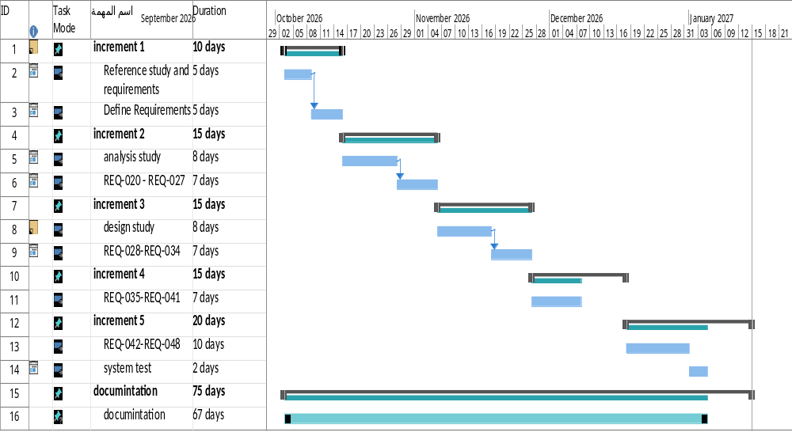
Project Plan (Gantt Chart)

